Slide 1
DELAYS & CANCELLATIONS: UNDERSTANDING THE PANDEMIC'S INFLUENCE ON AIR TRAVEL PROJECT 1 | GROUP 2
Arzoo Fatima
Cruzald Boholst
Derrick Smith
Justin Lent
Genesis Ruiz

Slide 2

HYPOTHESIS
There is a significant increase in the frequency of flight delays and cancellations during the pandemic compared to periods without a pandemic.

Slide 3

DATA FETCHING
Primary Dataset: Obtained from Kaggle, the "Flight Delay and Cancellation Dataset (2019-2023)" sourced from the Bureau of Transportation Statistics. Covers January 2019 to August 2023, providing essential variables like origin, destination, cancellation, and delays.
Supplementary Data - COVID API: Utilized the COVID Tracking Project's API for state-specific COVID-19 data, enhancing analysis by examining pandemic impacts on flight schedules.

Slide 4

DATA Cleaning
Data Preparation: We employed data slicing techniques to handle the dataset's size, facilitating efficient analysis of flight operation patterns. We also included cancellations in the delay count schedules, recognizing that although not all delays lead to cancellations, from a data standpoint, all cancellations are categorized as delays.

Slide 5
KEY TERMS
AIRLINE Airline name
ARR_DELAY Difference in minutes between scheduled and actual arrival time. (Early arrivals show negative numbers.)
CANCELLED Cancelled Flight Indicator (1=Yes)
DEP_DELAY Difference in minutes between scheduled and actual departure time. (Early departures show negative numbers.)
DEST_CITY City of destination for the flight
FL_DATE Flight date (yyyymmdd)
ORIGIN_CITY Origin Airport, City Name
ORIGIN_STATE Origin Airport, state abbreviation

Slide 6
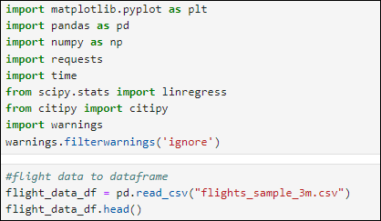
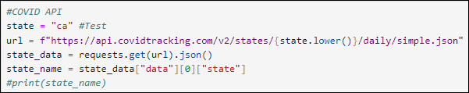
DATA PROCESSING
Import Libraries
Ignore Warnings
Read CSV Data
Display DataFrame Head
Set State Variable
API URL Generation
API Request
Display Status Code

Slide 7
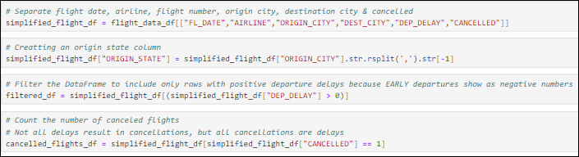
DATA PROCESSING
Create a new DataFrame
Add a new column – ORIGIN_STATE
Filter to positive departure delays, excluding early departures
Create a separate DataFrame (cancelled_flights_df) containing rows for canceled flights based on the "CANCELLED" column

Slide 8
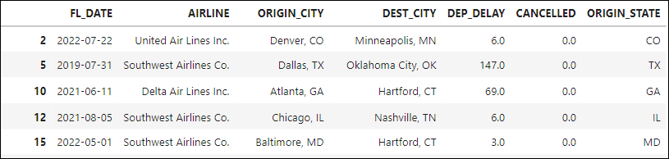
Dataset DISCOVERY Filtered DATAFRAME

Slide 9
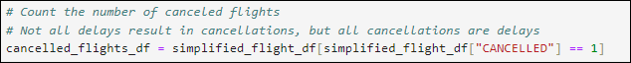
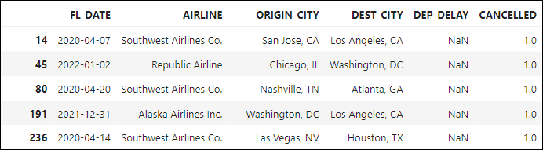
Dataset DISCOVERY cancellations DATAFRAME

Slide 10
overview
January 2019 - August 2023
Total number of flights delayed & cancelled: 992,843
Total number of flights cancelled: 79,140

Slide 11
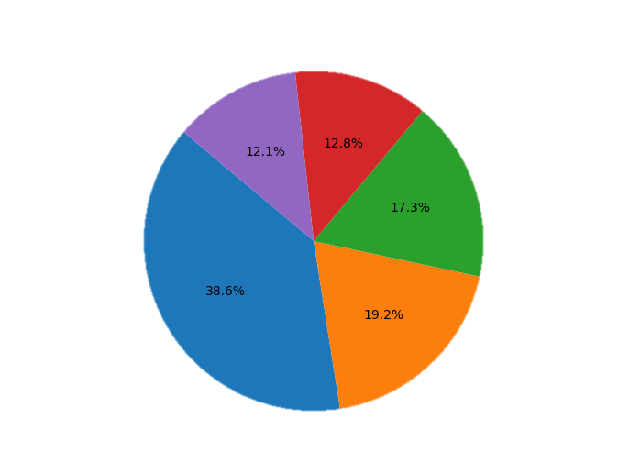
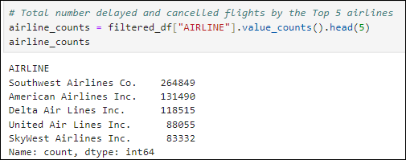

Top 5 airlines
United
Air Lines Inc.
SkyWest Airlines Inc.
Delta Air Lines Inc.
Southwest Airlines Co.
American Airlines Inc.

Slide 12
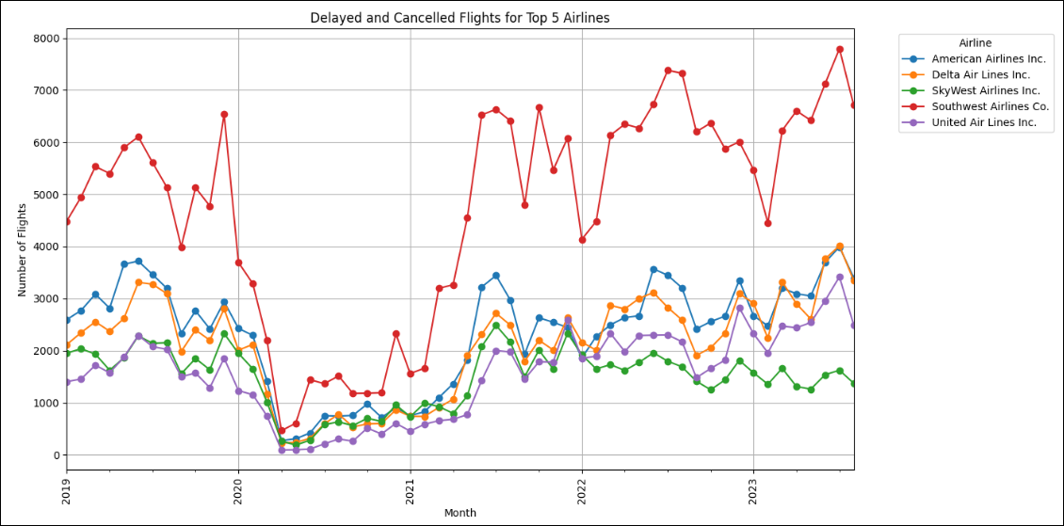
Top 5 airlines

Slide 13
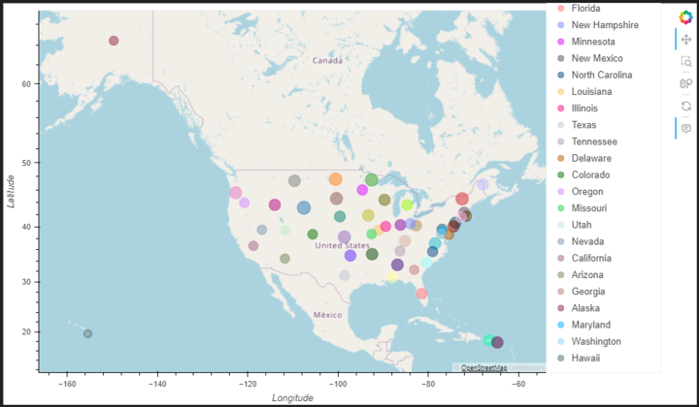
Average delays by Departure State

Slide 14
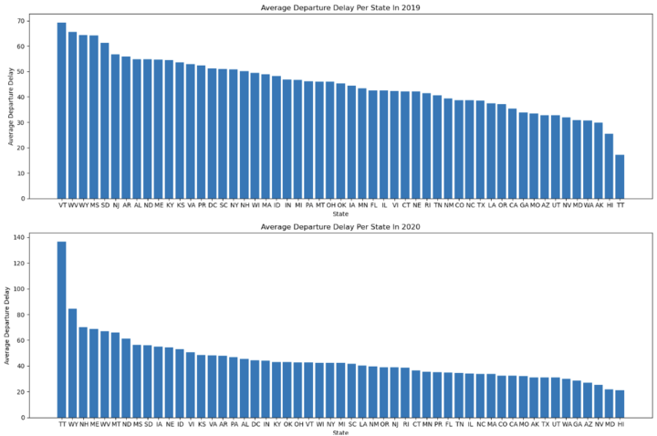
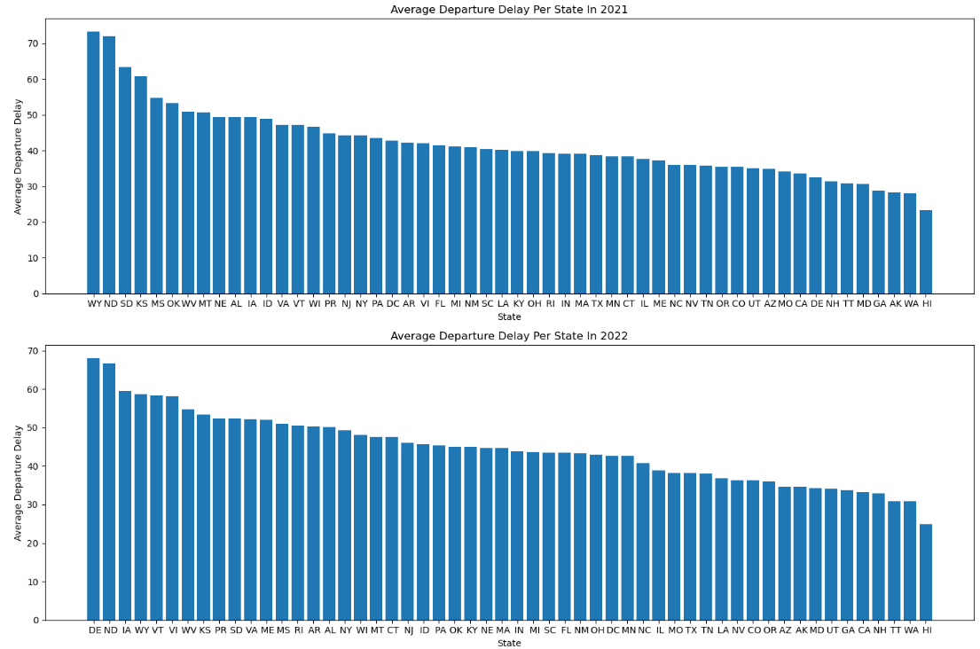
Average delays by Departure State per year

Slide 15
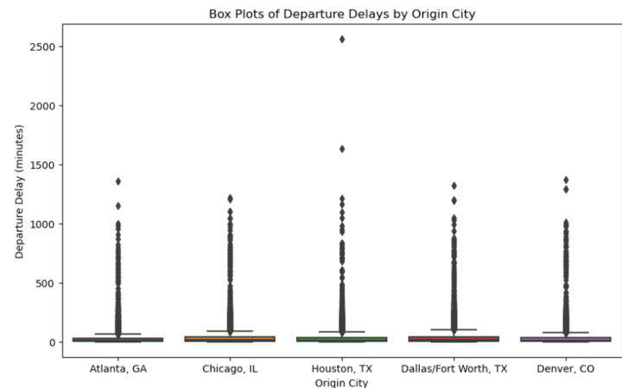
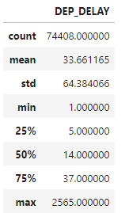
Top 5 CITIES
Analysis of Flight Delays in the Top 5 Cities During the Peak Pandemic Years, 2020-2021

Slide 16
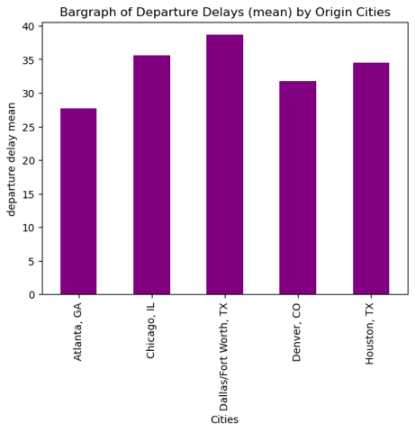
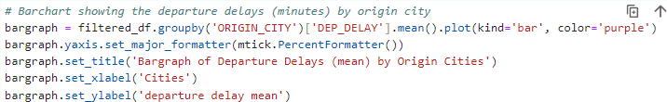
AVERAGE DELAYS BY TOP 5 CITIES

Slide 17
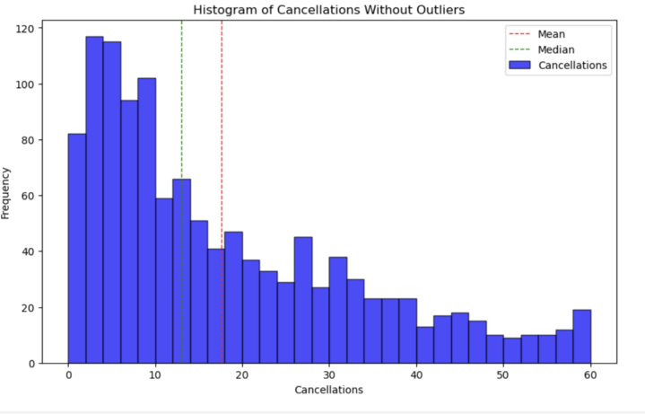
measures of central tendency

Slide 18
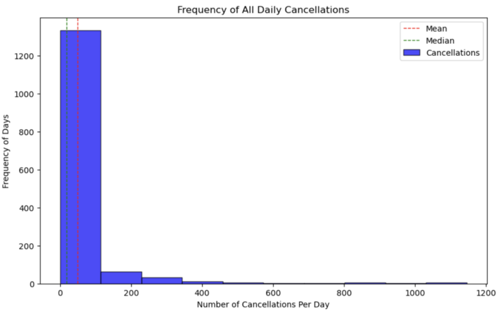
measures of central tendency

Slide 19
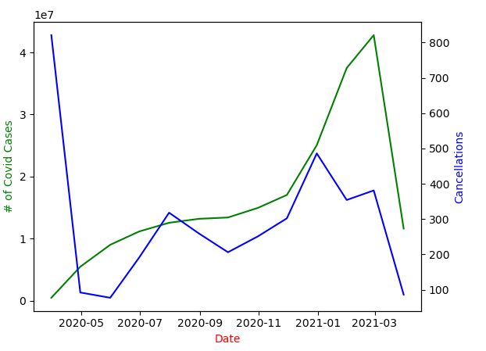
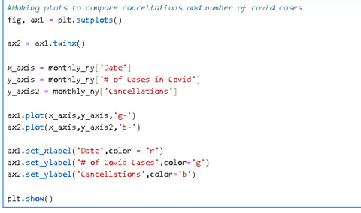
COVID-19 Cases vs Flight Cancellations

Slide 20
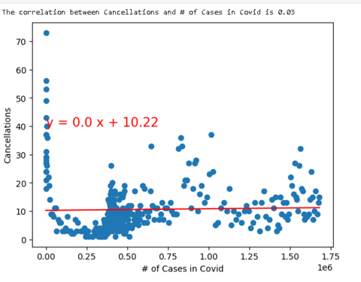
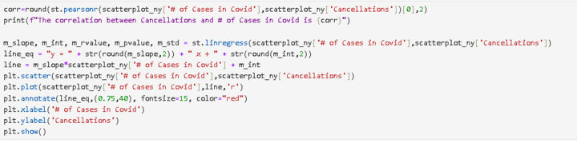
conclusion
Linear regression analysis was conducted to determine the relationship between cancellations and the number of COVID-19 cases from March 2020 to March 2021.
The analysis revealed no significant correlation between cancellations and the number of COVID-19 cases during this period, leading to the conclusion that these variables are not closely related.

Slide 21
Summary
Our project centered around flight cancellations and delays spanning from 2019 to 2023. Utilizing a dataset obtained from Kaggle, we preprocessed and cleansed the data to focus solely on delays and cancellations, ensuring relevance in our analyses. We also correlated the flight data with Covid-19 statistics from an external API tracking case numbers.
We organized our analysis by addressing the top 5 airlines, states, and cities, as well as investigating daily, monthly, and yearly cancellation trends. This allowed us to generate visualizations that revealed trends.
While we observed apparent trends when visualizing these datasets together, such as dips in flight frequency coinciding with pandemic peaks in 2020, our analysis revealed a weak correlation between the two sets of data, leading us to reject out hypothesis.

Slide 22
NEXT STEPS
Given the unexpected finding, we rejected our initial hypotheses.
While fewer flights logically lead to fewer opportunities for delays and cancellations, we learned through our analysis that a deeper familiarity with the dataset enables us to ask more insightful and targeted research questions.
Our next step would be:
Propose better questions for exploration
Revise our hypothesis based on alternative explanations that aligned with the data.
Investigate the number of flights during the COVID-19 period
While we've already examined delays and cancellations collectively, it would be intriguing to pinpoint the timeframe when most cancellations occurred.

Slide 23
Thank you
GitHub Repository & Branches
https://github.com/aradar1/Project-1---Columbia
Arzoo Fatima - ArzooF
Cruzald Boholst - cruz_branch
Derrick Smith - D3Smee
Justin Lent - JLent_branch
Genesis Ruiz - gjruiz_branch

